Slide 1
Object Detection and Autonomous Navigation
Luca Ciampaglia, Nishit Popat, and Jacob Ward

Slide 2
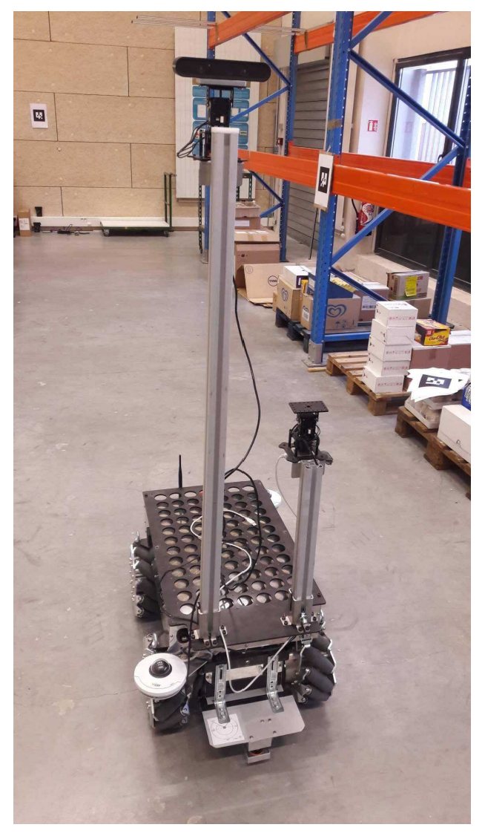
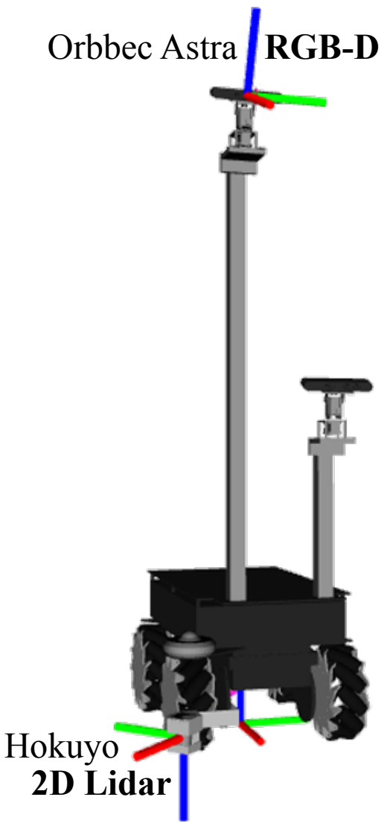
Foundation
Object Detection
The process of identifying and locating objects in the robot's environment, typically using sensors like RGB-D cameras
Enables real-time interaction with dynamic environments by classifying objects and determining collision-free trajectories
Autonomous Navigation
The ability of a robot to move on its own through an environment using sensors like 2D LIDAR to understand its surroundings
Involves creating a dynamic, grid-based costmap of the environment and adjusting robot behavior to ensure safe operation

Slide 3
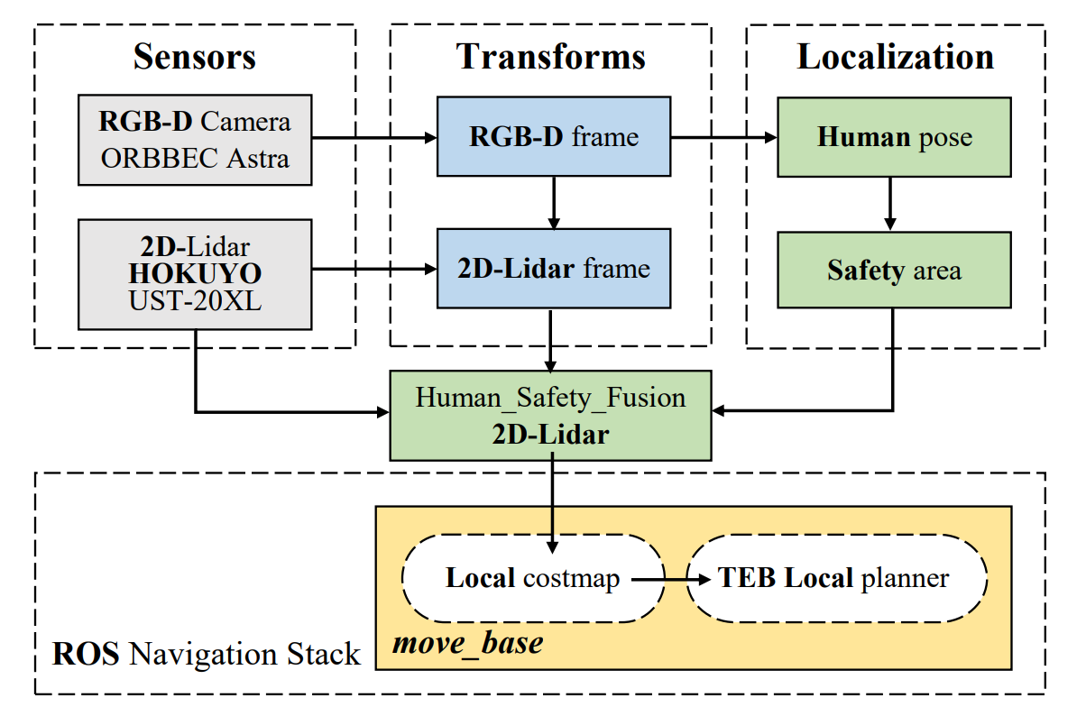
Chosen Algorithmic Paper
"Human-aware Robot Navigation in Logistics Warehouses"
M. A. Kenk, M. Hassaballah, and J.-F. Brethe (2019)
Human-Aware Navigation Framework
Integrates RGB-D data to detect humans with a pre-trained YOLO v3-Tiny model based on the COCO dataset (large-scale object detection)
Generates dynamic safety zones around detected humans
ROS Navigation Stack Integration
Uses local costmaps obtained from 2D LIDAR for path planning
Optimized using the Timed Elastic Band (TEB) local planner to navigate around humans and obstacles

Slide 4
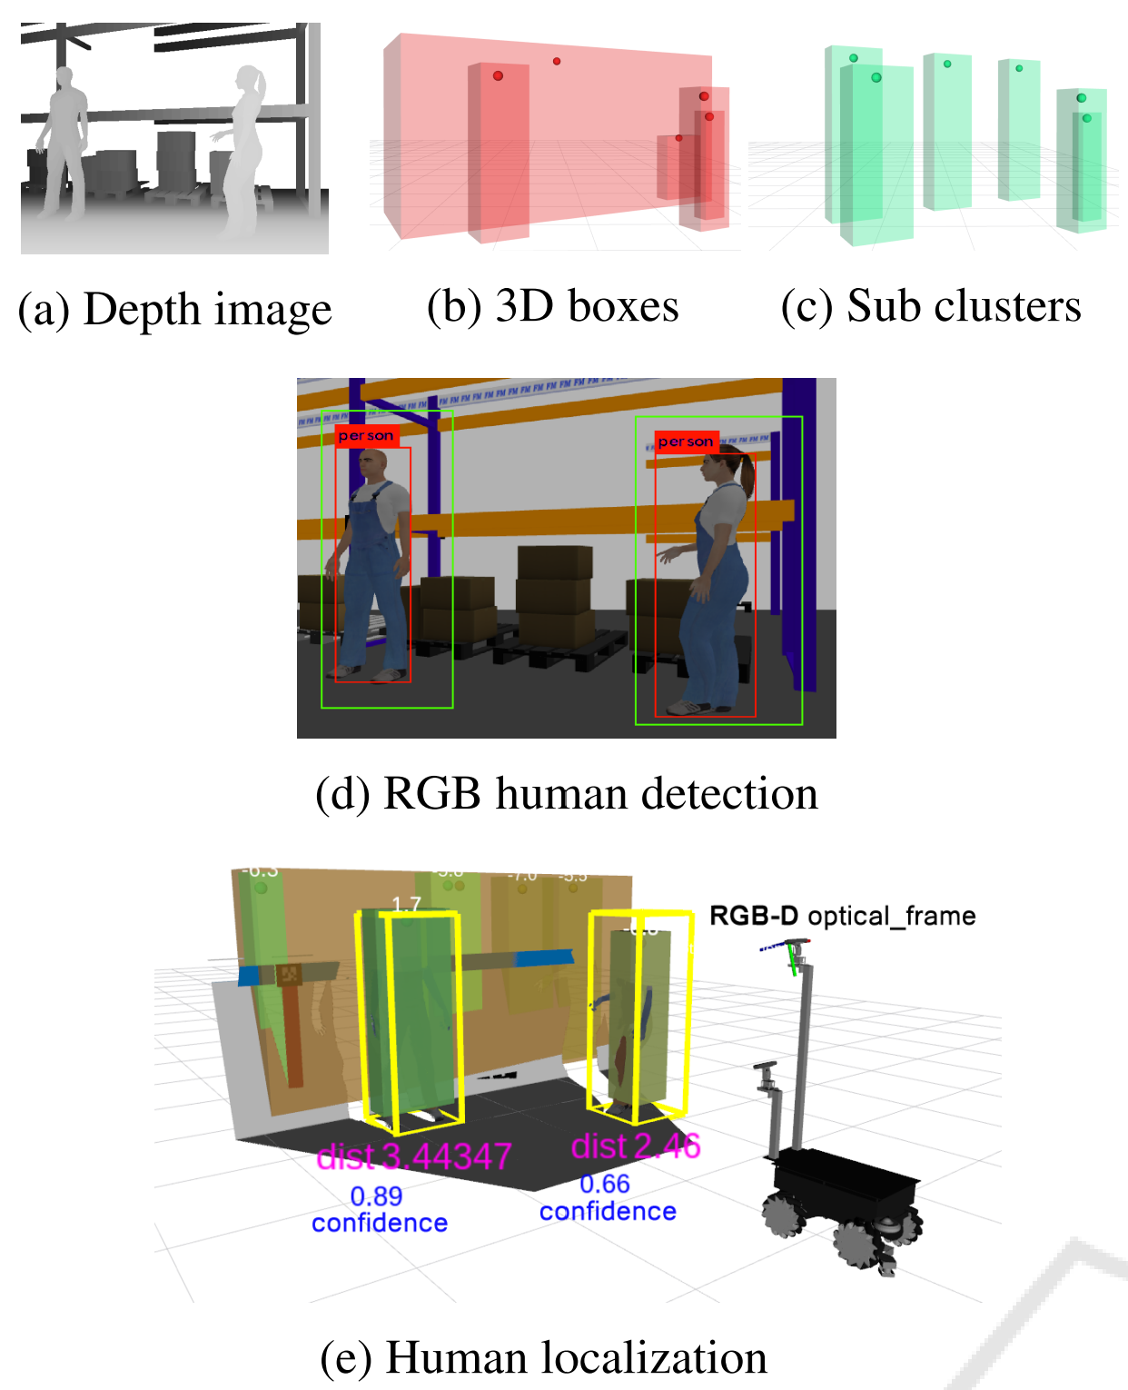
Introduction and Motivation
Why Human-Aware Navigation?
Traditional navigation systems prioritize obstacle avoidance but fail to consider human comfort in dynamic environments
Human-aware systems address these gaps, enabling safer and more intuitive robot behavior in shared spaces
Project Focus
Implement the studied human-aware navigation system
Evaluate how well the system scales and adapts to small, office environments than those tested in the original framework

Slide 5
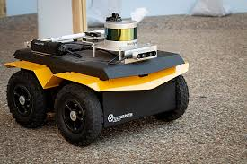
Problem Statement
Design an autonomous navigation system for a Clearpath Jackal UGV to operate in a Gazebo environment that strikes a balance between human safety and operational efficiency
Enable dynamic, real-time detection of humans using Intel RealSense D455 and YOLO v3
Create and integrate flexible safety zones based on the type of obstacle detected
Handle complex environments with several obstacles (human and non-human)
Optimize the robot’s behavior for safe, efficient navigation in the environment using 2D LIDAR

Slide 6
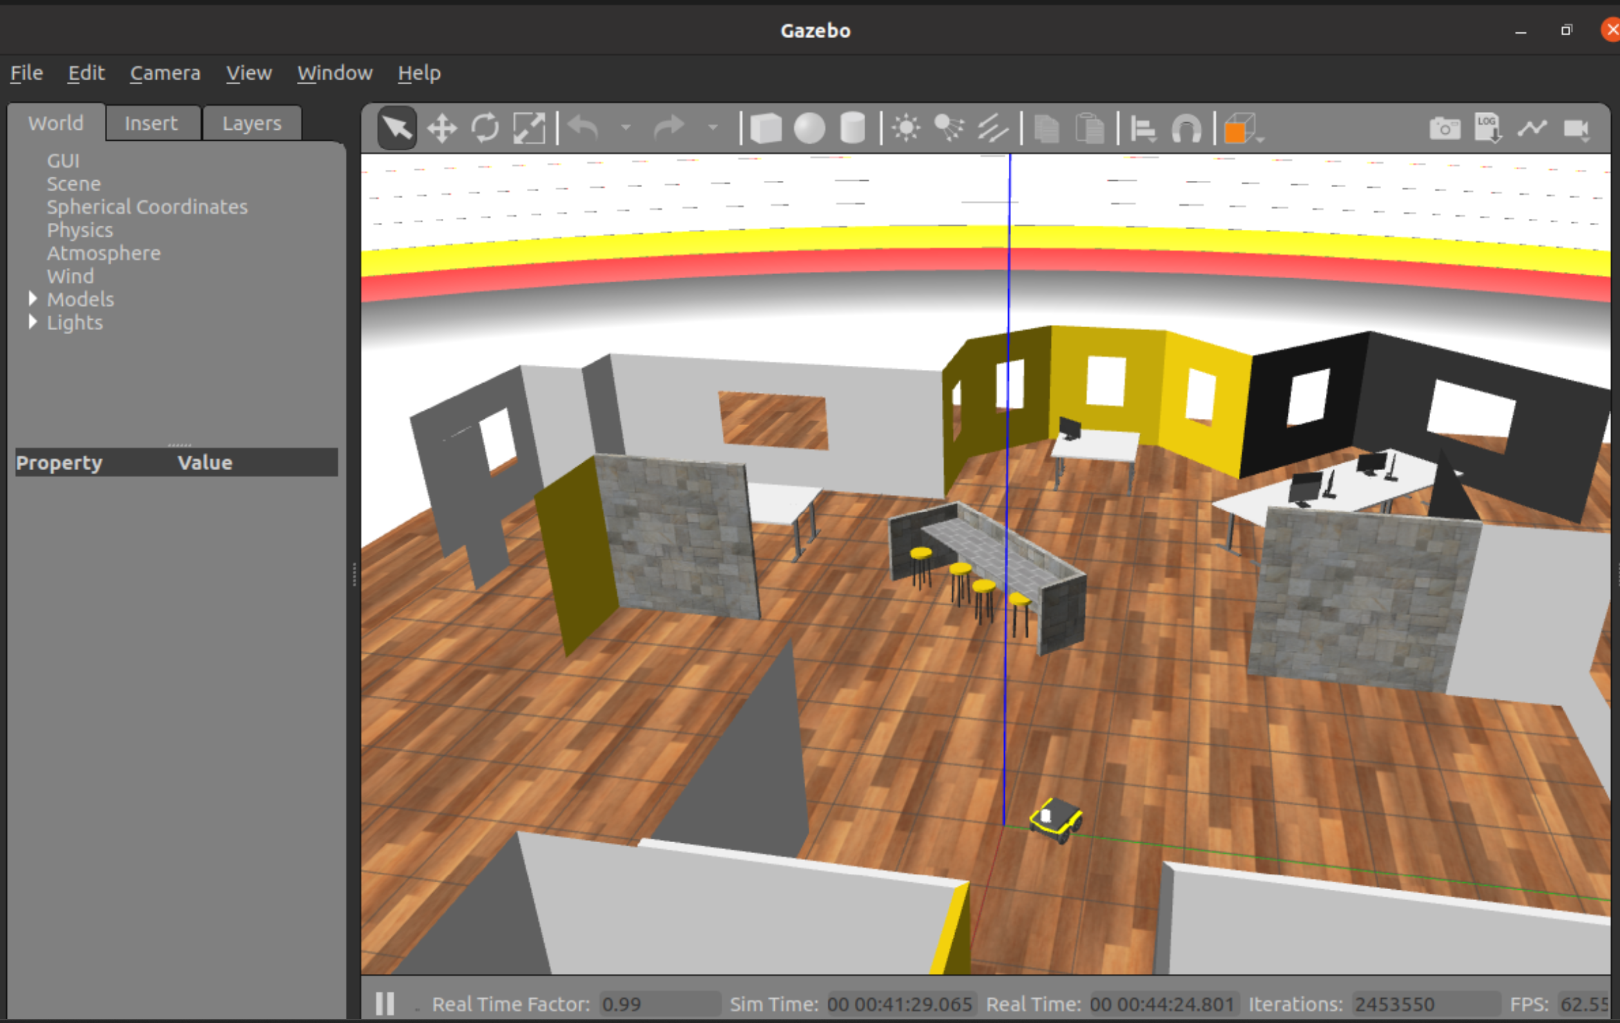
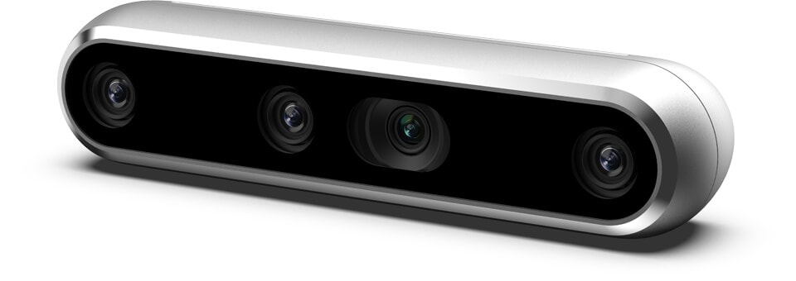
Traditional Navigation Approach
Localization
Navigation
Control
Using AMCL
SLAM for Gmapping
Using ROS navigation stack
move_base framework
A* path planning
Path planning to avoiding obstacles with the help of sensor data
Intel RealSense Depth Camera D455
Notes:
Slide 1:
Localization: where am I in the environment?)
SLAM creates Map of environment and localizes simulateously , in specific we used the Gmapping algorithm as it was more memory efficient
Used AMCL for localization. This is done in so that the robot actually knows an estimate of its pose in the map.
Navigation: (where should I go? And how do I get there)
For navigation, we used the A* to find the path detecting obstacles. We used 2d nav goals for setting goals. We tested using the move_base framework using the ROS_nav stack.
Control: (what's in my way and how do I avoid / get past it)
The global cost-map is overlayed onto the local cost-map to help the bot understand, where it can go and where it can not. The obstacles are detected in the local cost map
2D nav goal used to send the nav goals.

Slide 7
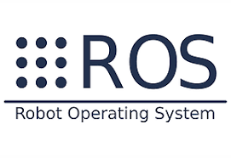
Experimental Setup
Environment
Clearpath office environment in Gazebo
Includes narrow aisles, open spaces, and obstacles to roughly mimic the layout of a logistics warehouse
Robot Specifications
Clearpath Jackal UGV equipped with an Intel RealSense Depth Camera D455 and a 2D LIDAR scanner
Software
ROS Navigation Stack and custom Python ROS nodes
Notes:
We used clearpath office gazebo sim
WE used custom updated jackal with a 2D lidar scanner and a realsense depth camera
We used ros 20.04, Ros noetic and ROs nav_stack

Slide 8
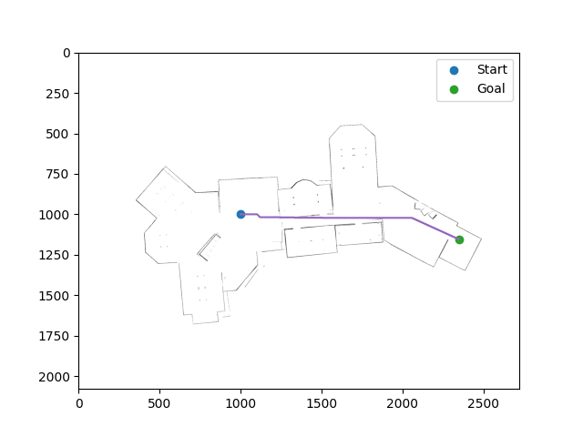
Navigation: Gmapping and AMCL​
Total path distance: 1414.2031021678313
Notes:
Below you can see example of GMapping, done, amcl screen in rviz. On the right you can see the result of the A* using 2d occupancy grid. It was able to find the path and avoiding obstacle and the start and the goal were set to find the path.

Slide 9
Demo Video
Click here

Slide 10
Object Detection: YOLO and HSA
YOLO v3
Utilizes the YOLO ROS package
Performs object detection on the RGB Image output of the Realsense Camera
YOLO Postprocessing
Maps from the pixel coordinates of the detected objects to their Cartesian coordinates in space
Utilizes data from the Realsense Depth Image output
Human Safety Area (HSA) Fusion
Generates a circular safety region around each detected person based on the Cartesian coordinates
Manipulates LIDAR scan data to insert safety regions

Slide 11
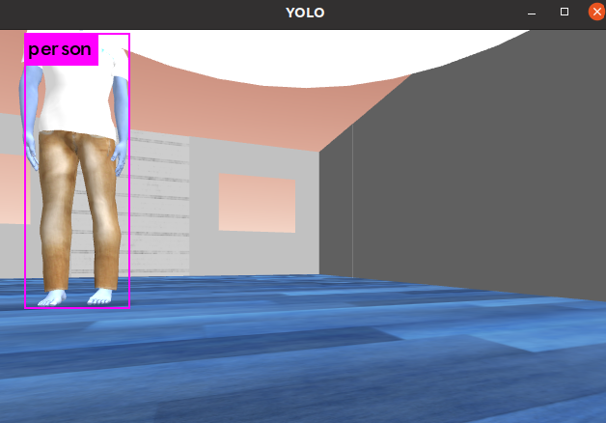
You Only Look Once (YOLO) v3
YOLO Dataset:
COCO Dataset, with 80 Classes
Limitation:
CPU-intensive, and could not be run at adequate speed on the Ubuntu Virtual Machine
YOLO ROS Implementation:
M. Bjelonic, "YOLO ROS: Real-Time Object Detection for ROS", ETH Zurich

Slide 12
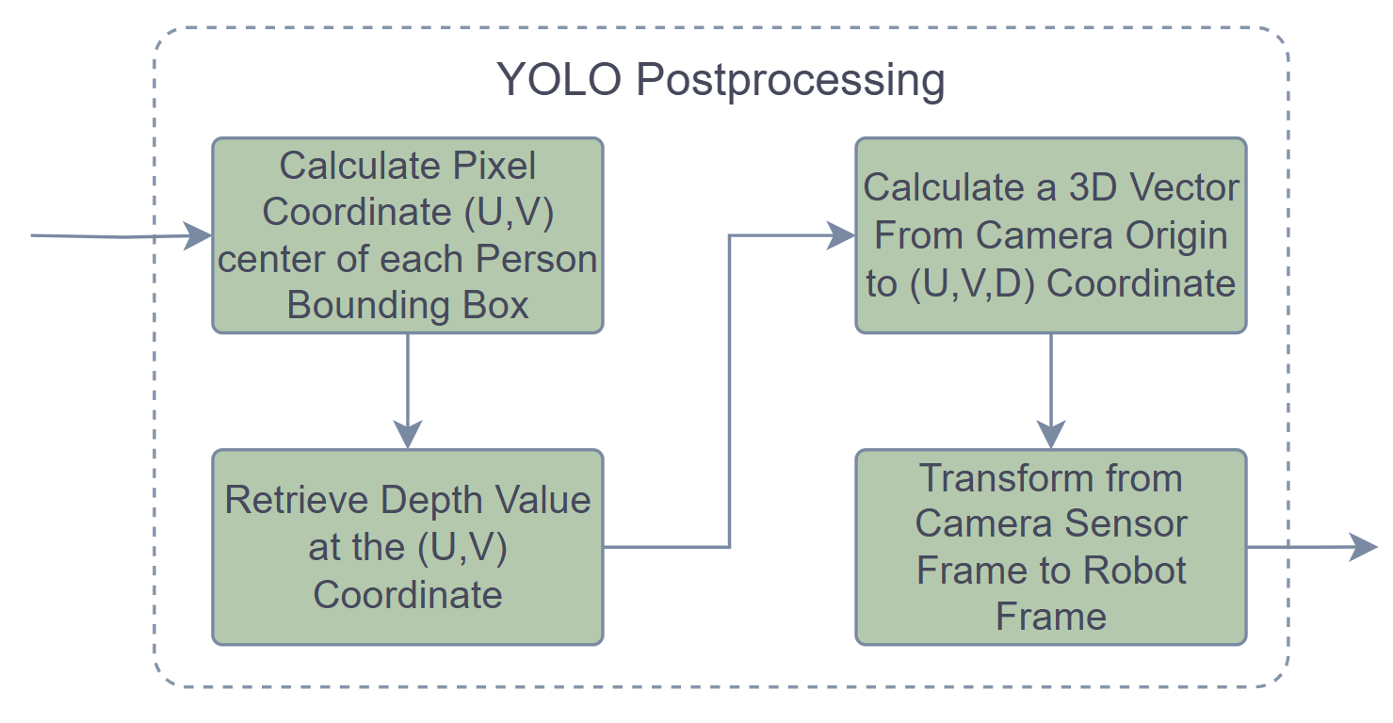
YOLO Data Processing
PROBLEM:
YOLO outputs bounding boxes of all detected objects in pixel coordinates
OUTPUT:
Convert all detected 'PERSON' objects from pixel coordinates to local Cartesian coordinates

Slide 13
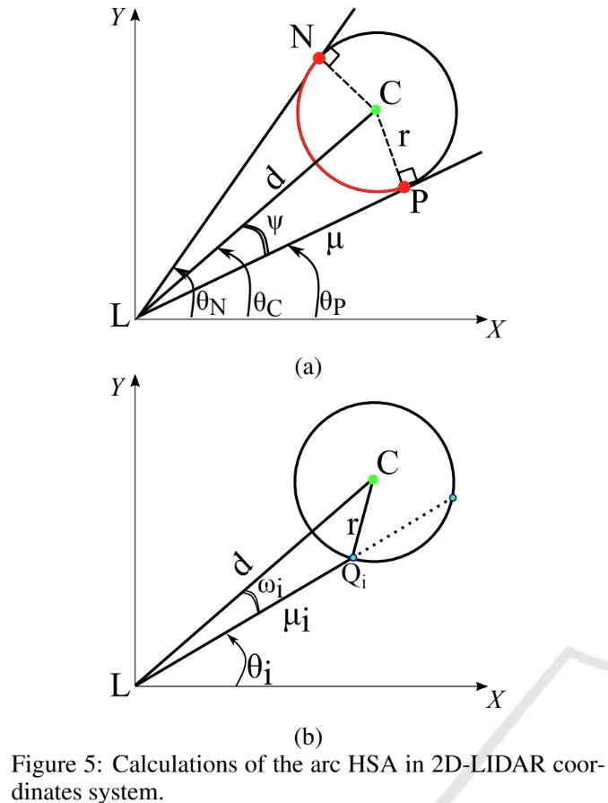
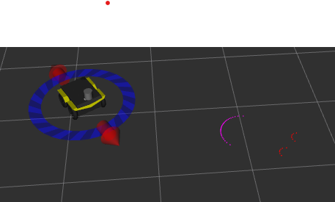
Human Safety Area (HSA) Fusion

Slide 15
Conclusion
The Gazebo simulation confirmed the method's effectiveness in adjusting robot behavior around humans using fine-tuned parameters
The algorithm failed to give expected good results. Proposed a new strategy based on a 2-step method:
Use the depth signal to cluster and identify 3D boxes likely to be humans
Compute a human presence confidence index from the RGB signal
Notes:
The Gazebo simulation environment experiment proved that the method effectively modifies robot behavior when encountering humans in the workspace after using fine-tuned parameters.
In this paper, we study a difficult problem namely human aware navigation in warehouses where research results for human detection do not give the expected good results.
2 point strategy:-
Use the depth signal to cluster and identify 3D boxes likely to be humans
Compute a human presence confidence index from the RGB signal

